Slide 1
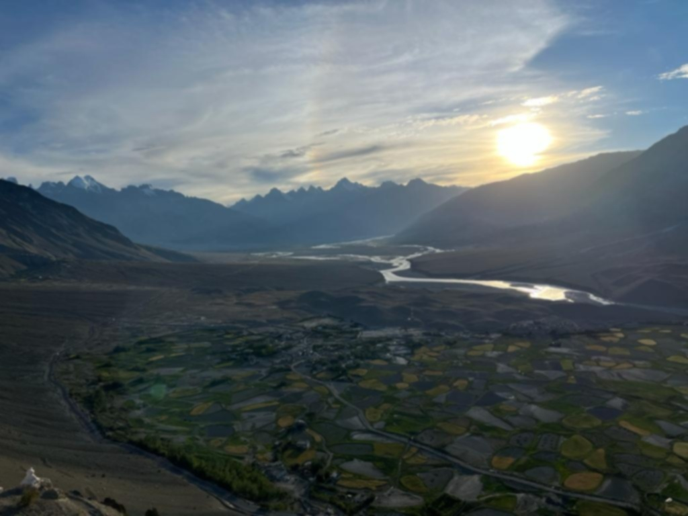
Indian Mega Trails
Celebrating Incredible India’s Wilderness…

Slide 2
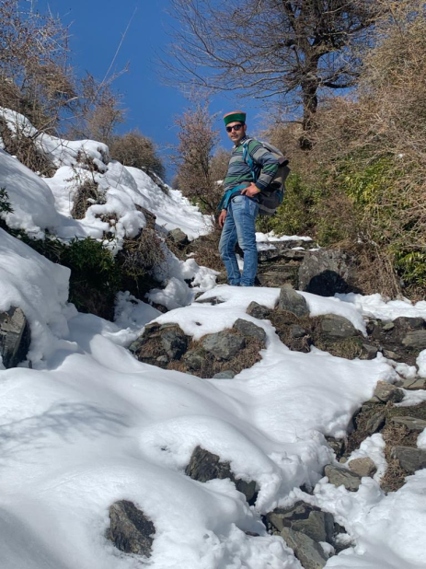
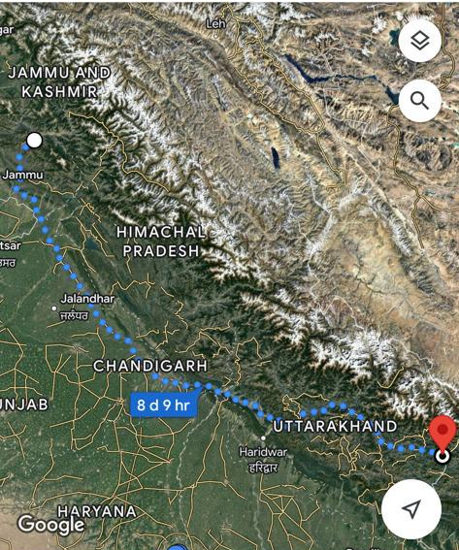
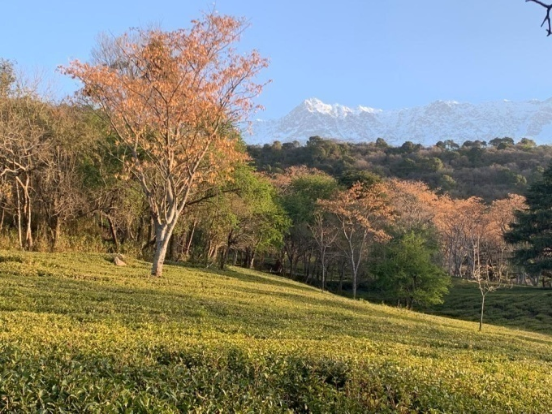
Western Indian Himalayan Trail
Patnitop ( Jammu), Kashmir, Ladakh, Spiti, Garhwal, Kumaon, Jauljibi, Kalapani ( Tri Junction area) (Pithoragarh, Uttarakhand)
Distance : 1100/1200 kms Approx

Slide 3
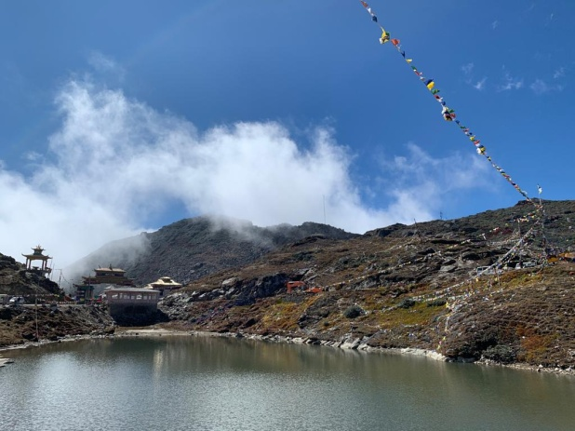
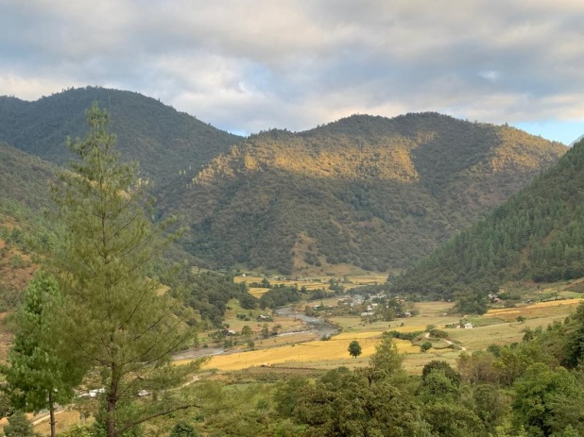
Eastern Indian Himalayan Trail
Mirik Lake to Darjeeling, Sandakphu, Dzongri, Changu Lake, Coronation Bridge, Bhalukpong, Tawang, Pasighat, Namdapha NP & Tiger Reserve( Arunachal Pradesh)
Approx distance 1000/ 1200 kms

Slide 4
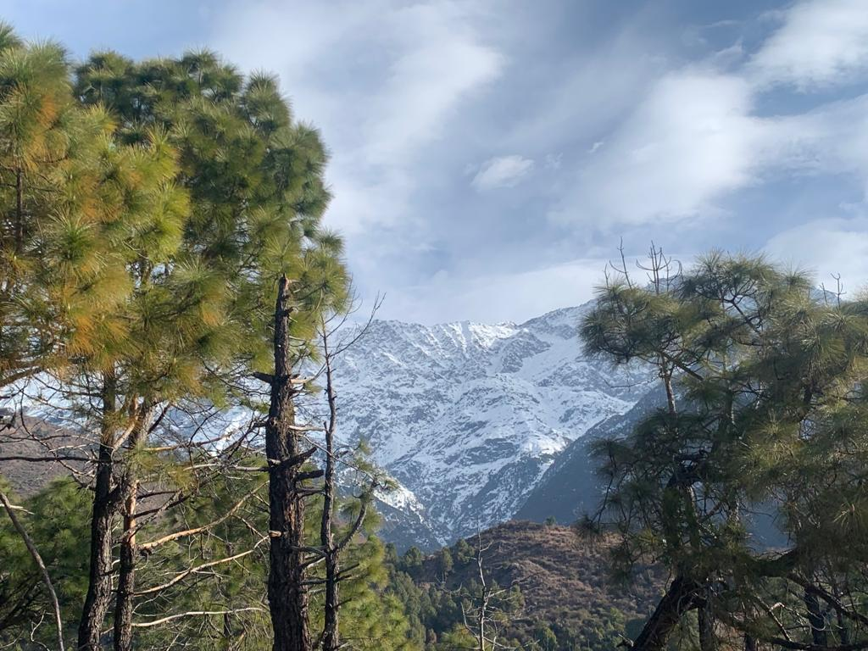
Trans Himalayan Trails Extension
Western & Eastern Trail Extension in Nepal and Bhutan
Great Himalayan Trail in Nepal : Joljibi/ till the Singalila Ridge
(Kanchenjunga area)
Distance : 1700 kms
Trans Bhutan Trail : Haa in west Bhutan till Trashigang in the east
Distance approx. : 400 kms

Slide 5
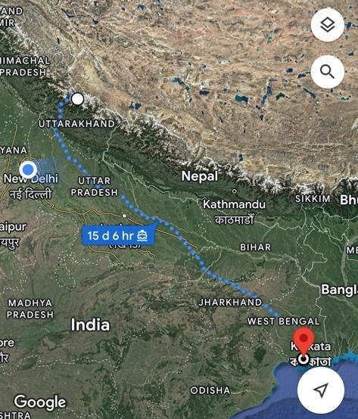
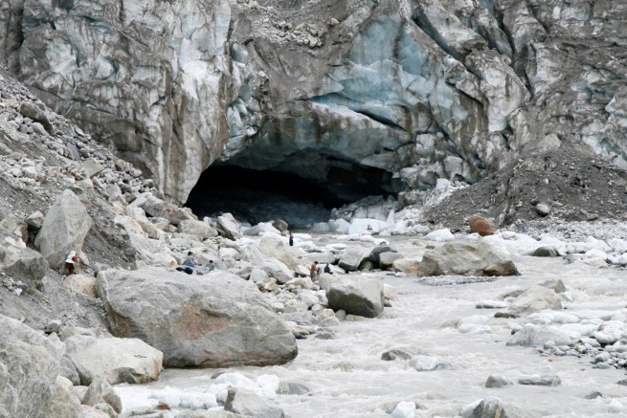
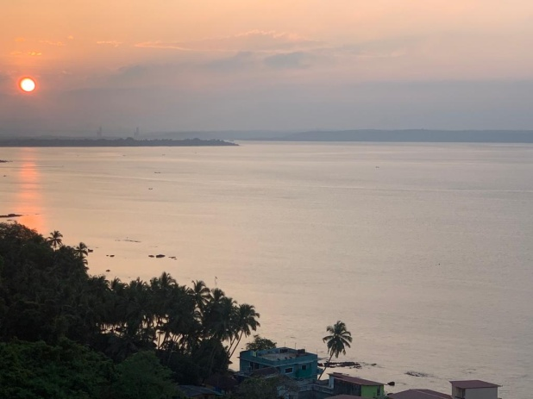
Ganga Heritage & Nature Trail The soul of India
Gaumukh- Uttarkashi – Rishikesh – Haridwar - Varanasi - Ganga Sagar
Distance approx. : 2650 kms

Slide 6
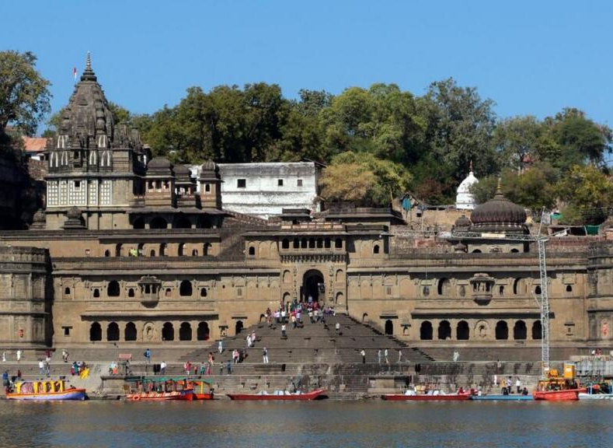
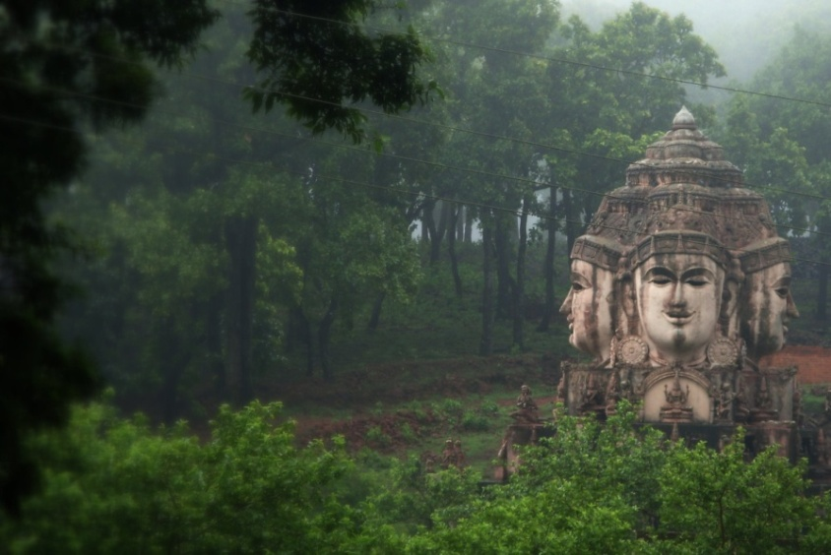
Narmada River Trail
The Heart of India
Photo: @wikipedia
Jageshwar, Gujarat - Omkareshwar, Jabalpur, Madhya Pradesh - AmarKantak, Chattisgarh
Distance approx. : 1100 kms

Slide 7
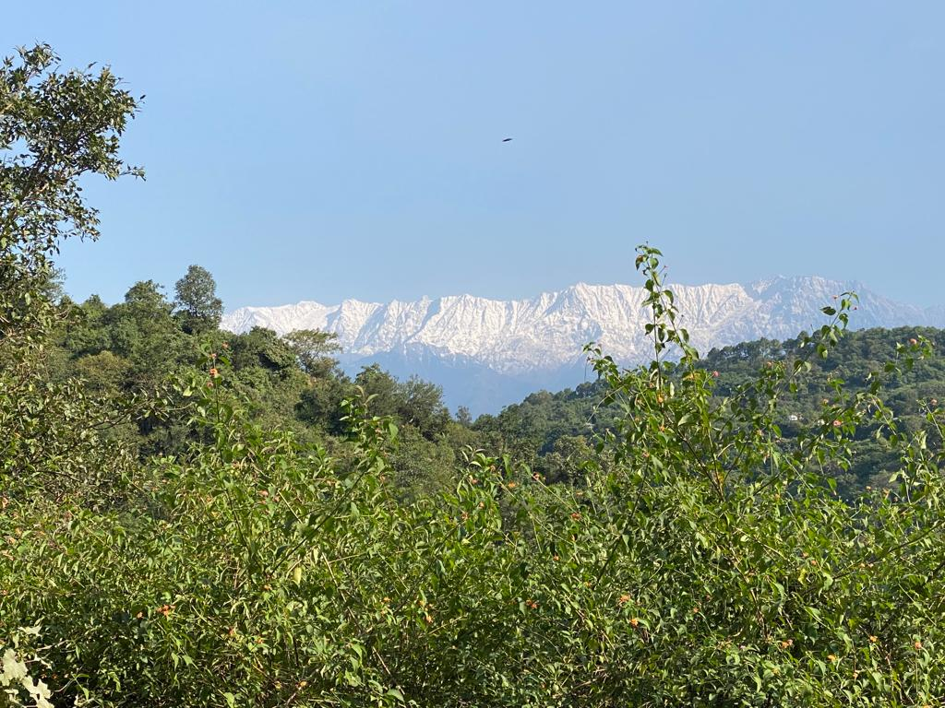
Mega Trails & Indian States
Western Indian Himalayan Trail
Jammu & Kashmir
Ladakh
Himachal Pradesh
Uttarakhand
Eastern India Himalayas Trail
West Bengal
Sikkim
Assam
Arunachal Pradesh
Ganga Heritage & Nature Trail
Uttarakhand
Uttar Pradesh
Bihar
Jharkhand
West Bengal
Narmada River Trail
Gujarat
Madhya Pradesh
Chhattisgarh

Slide 8
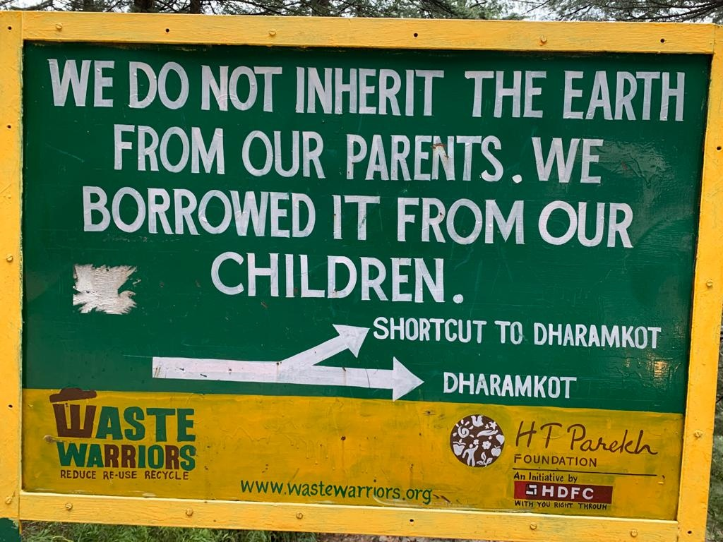
Vision
Global model for Sustainable Tourism
Integrate far flung regions into the mainstream
Generate economic activity
Employment
Empower communities
Border Tourism
Ancillary Trails
Hub for responsible adventure travel

Slide 9
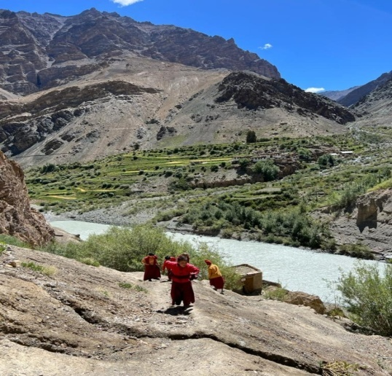
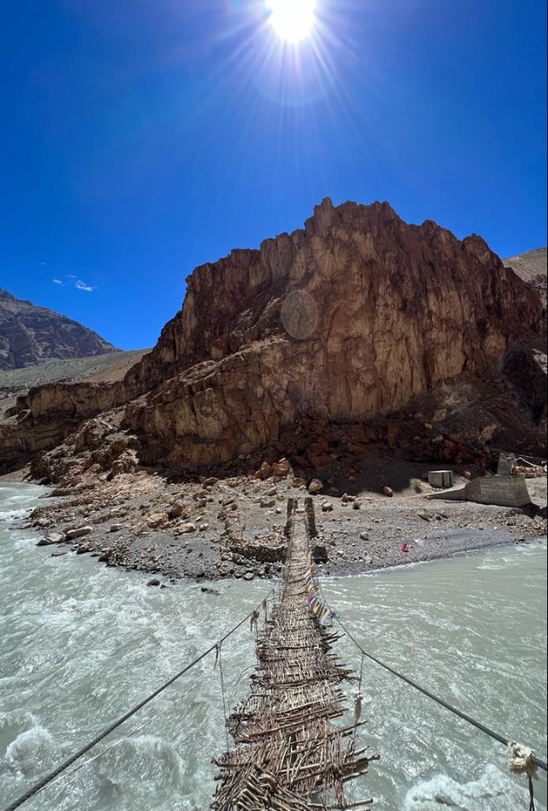
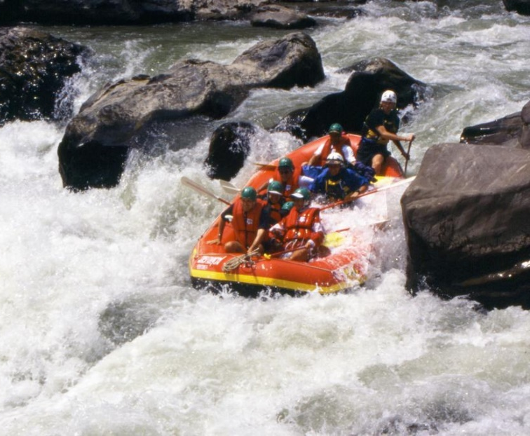
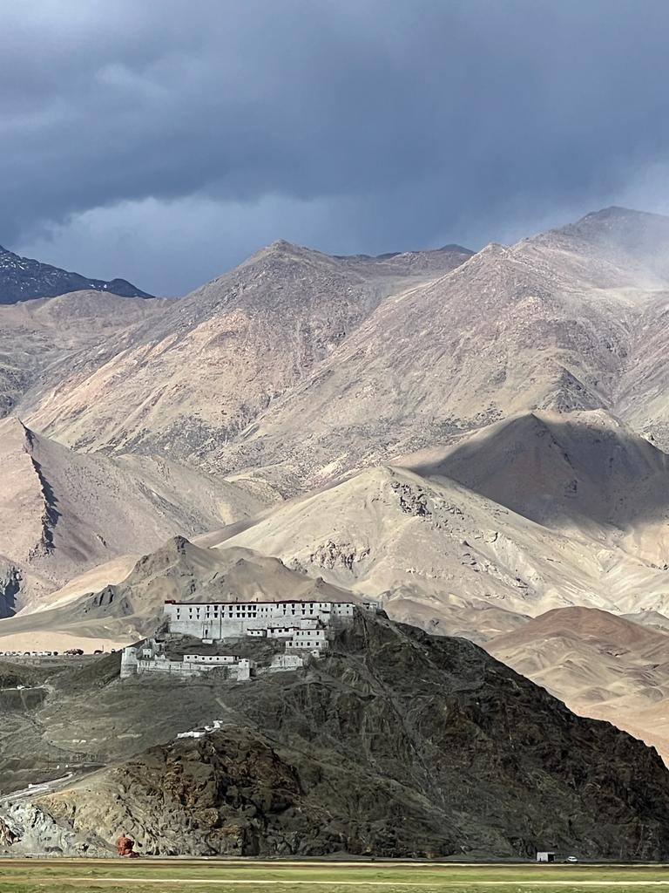
Game Changer for remote regions of India
Employment
Economic Development
Responsible Adventure Tourism Hub
Border Tourism

Slide 10
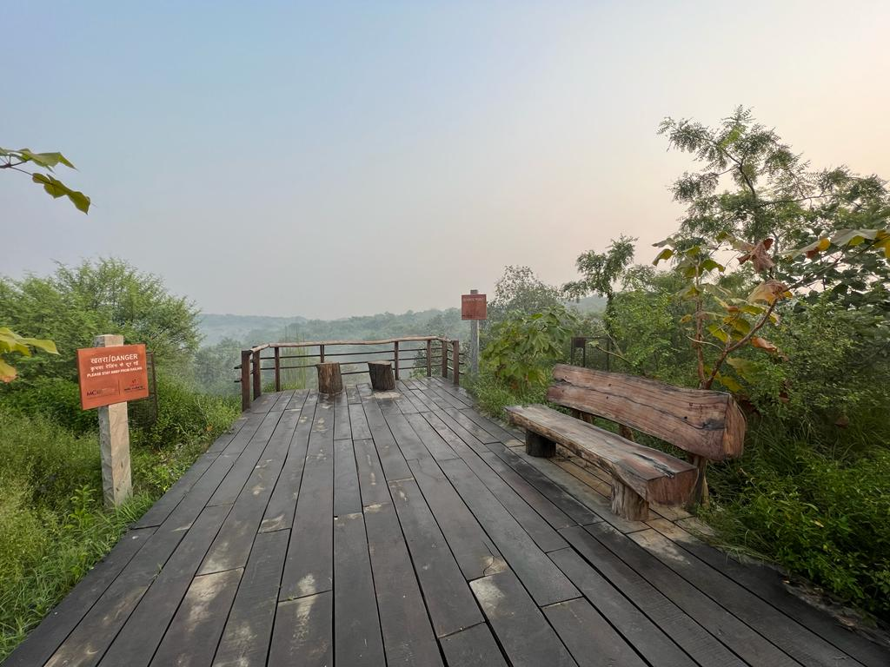
Trails with a difference…
Signposting : Every 250 m & at crossroads. QR codes
Small bridges where required
Secure danger zones
Avoid road hiking as much as possible.
Avoid towns & highly populated areas to enhance the wilderness experience
Digital Map
Trail App
Nature interpretation along the route

Slide 11
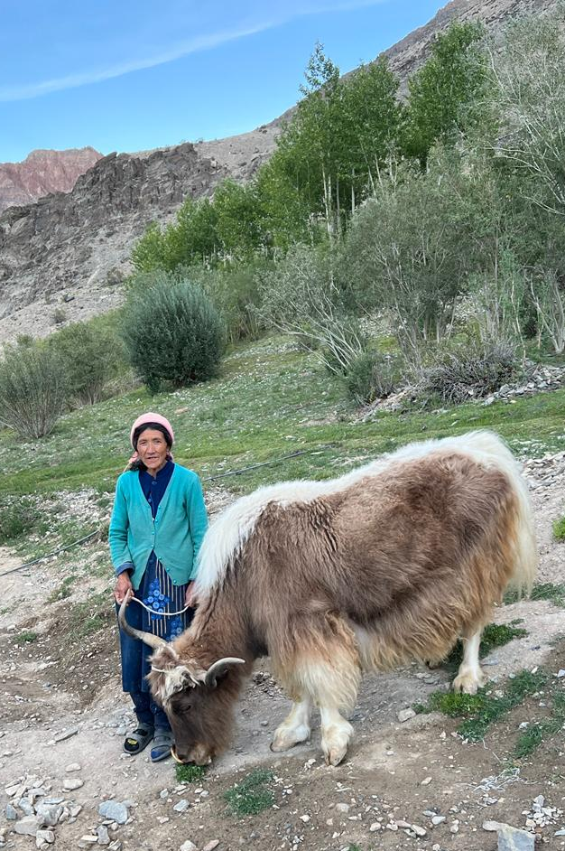
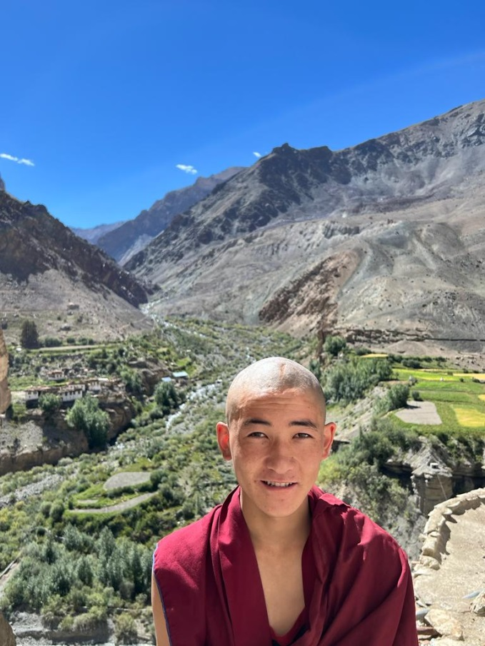
World Class Experience
Curated by local host community

Slide 12
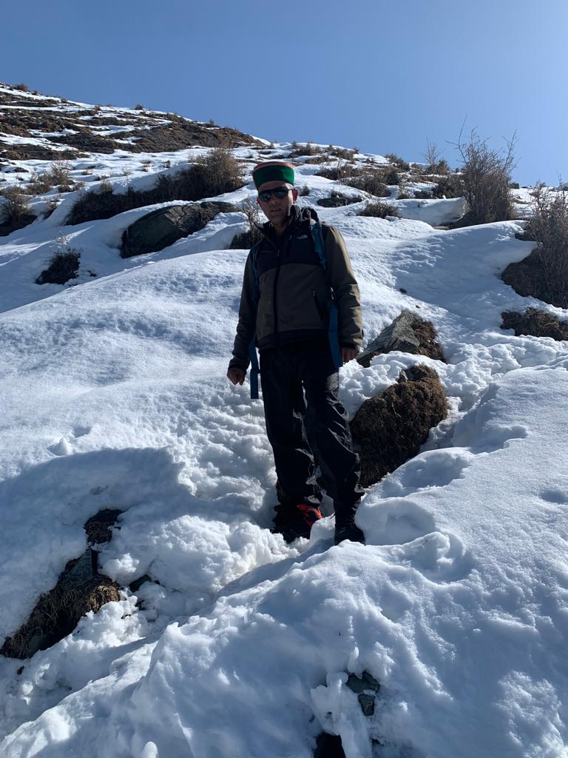
Local Community
Homestays & Community Camps
Every 15-20kms (terrain dependent)
Hygienic accommodation & food
Bio break stops
Renewable energy
Waste Management
Drinking water
Local Guides
Nature interpretation
First Aid
Rescue Posts
Grocery stores
Communication through Satellite
phone (where no network available)

Slide 13
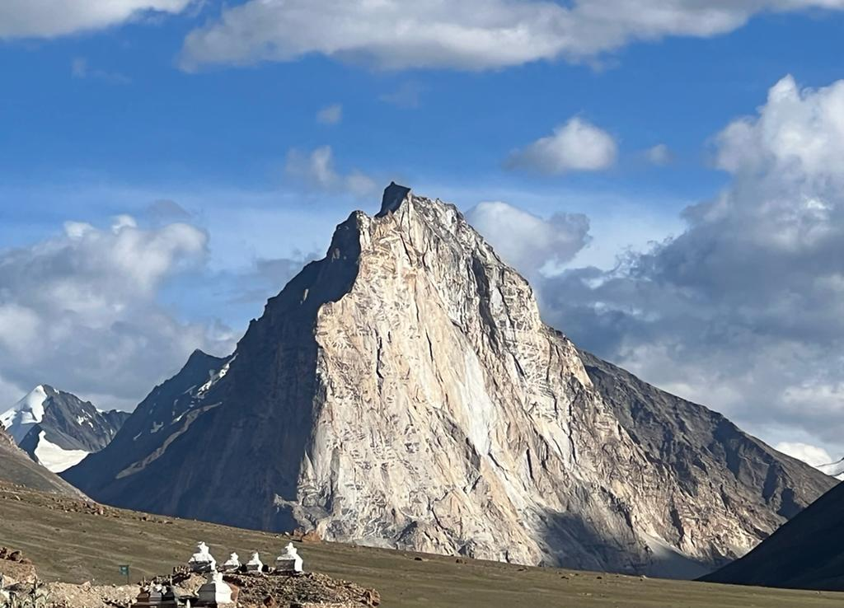
Access
Thru Hike – The entire trail
Point to Point- Sections of the trail
Online reservation system for trail and homestays
Insurance & rescue cover
Digital maps
Mobile app
Access Management
Sustainability fees

Slide 14
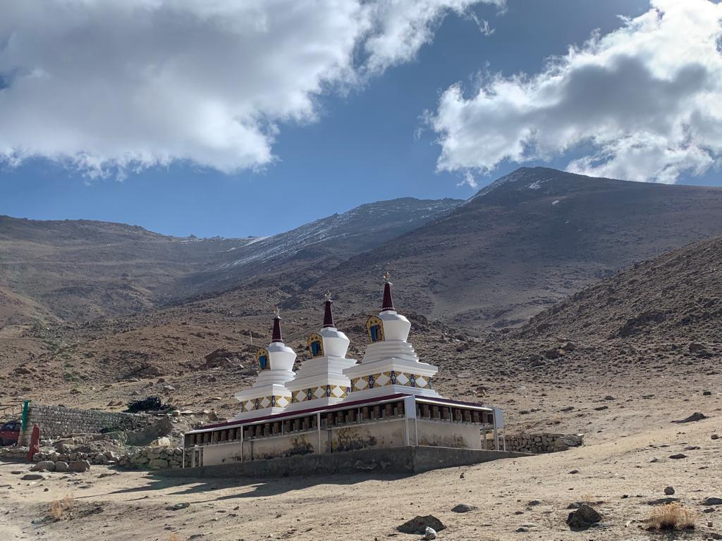
Communication
Mobile connectivity / Wi-Fi at Home stays / community camps
Satellite phones (DSPT model in Ladakh) through Indian gateway for remote places

Slide 15
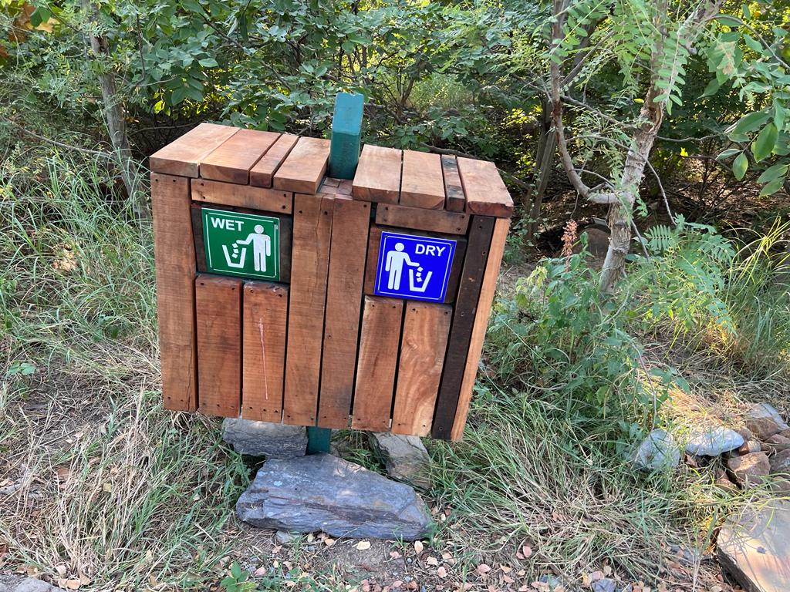
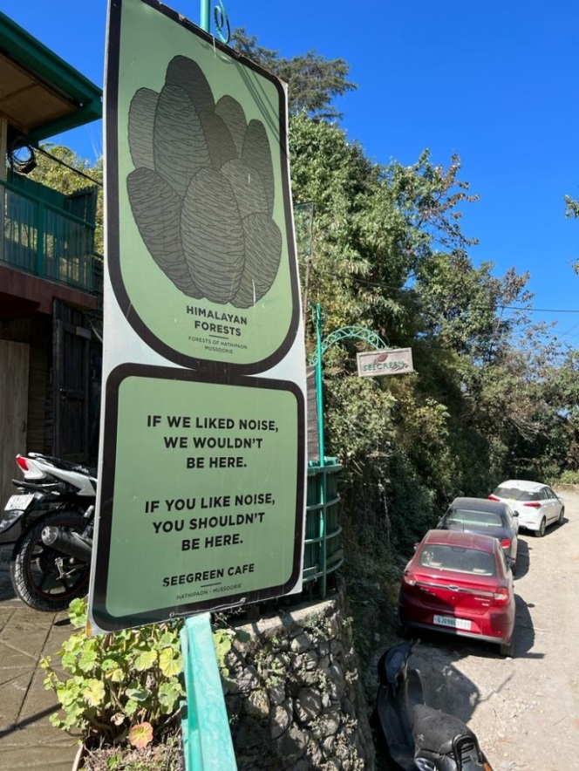
Sustainability
Sustainable Tourism Criteria of India
Low carbon footprint
Renewable energy / solar
Leave no trace….
Single use plastic free zone
Waste Management

Slide 16
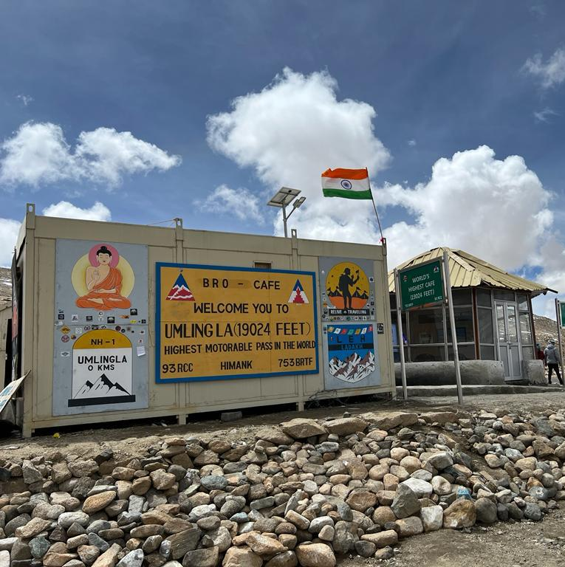
Governance Model
SPV
Not for profit
For Social welfare
Online/ offline permit model
Insurance & rescue
SPV
Indian Forest Service
Ministry of Tourism
State Government
Ministry of Defence
Role of SPV:
Administration
Route Maintenance
Trail infrastructure
Training
Local Community
Campsite, Reservation system
Rescue
Insurance

Slide 17
Possible Landowners
Revenue land
Restricted Revenue Land
Forest Land
Reserve Forest
National Park
Eco-Sensitive Zone
Border Regions \ Defense
Private Land
Trail Ecosystem
Main Trail corridor
Associated Side Trails
Parking Areas
Shelters
Campsites
Home Stays
Scenic Vistas
Governing Bodies
Trail Governing Mechanics
Three Pillars of Governance
Land Management agencies
Permit and access control
Trail Economics and Revenue Models
Estimated Capital Expense for 100km stretch of a trail in first phase
Estimated operation and Maintenance cost
Estimated yearly Revenue Generation fro a 1000 km stretch of a trail
Mega Trails Governance
Access Control
Revenue Model

Slide 18
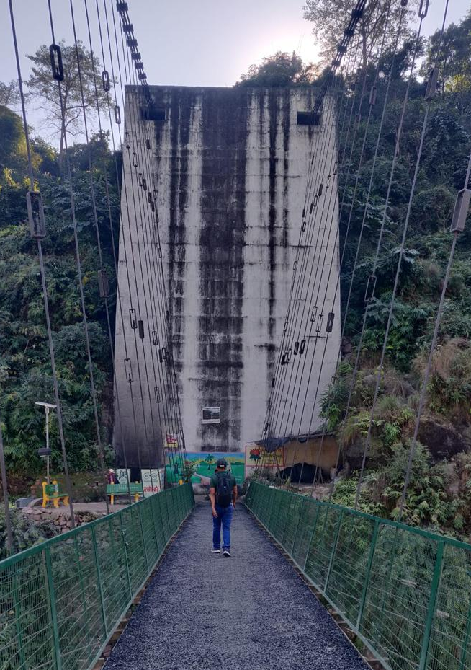
Mega Trail Governance
Trail Governing Mechanics
Three Pillars of Governance
Permit & Access Control
Trail Economics & Revenue Models

Slide 19
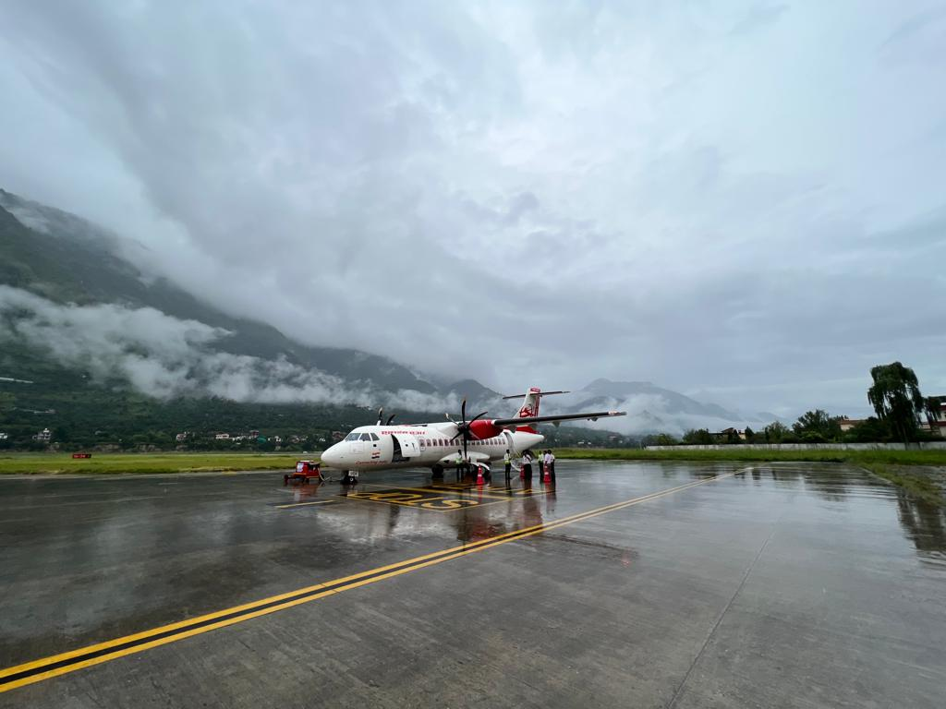
Air Connectivity
OPERATIONALIZE:
Chinyalisaur Uttarakhand
Gauchar Uttarakhand
Pithoragarh Uttarakhand
Kargil Ladakh
Thoise Ladakh
Mechuka Arunachal Pradesh
STREAMLINE OPERATIONS:
Kullu Himachal Pradesh
Shimla Himachal Pradesh
Pasighat Arunachal Pradesh
Ziro Arunachal Pradesh
GREENFIELD:
Karsha Ladakh
Kaza Spiti, Himachal Pradesh
Yambung Sikkim

Slide 20
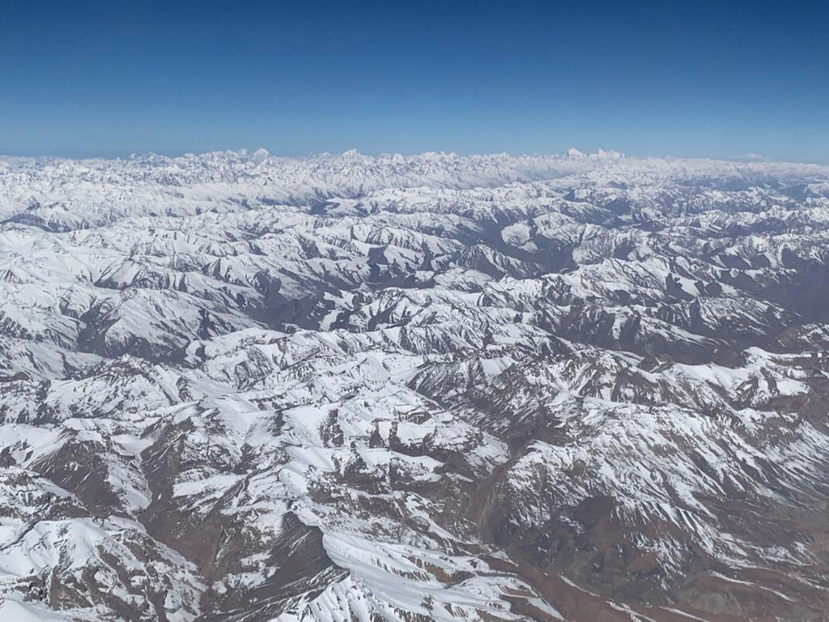
GLOBAL TRAILS
GREAT HIMALAYAN TRAIL NEPAL 1700 km
https://bit.ly/3fVANYu
TRANS BHUTAN TRAIL 400 km
https://bit.ly/3A7vc8s
APPALACHIAN TRAIL 2,200 miles
https://bit.ly/2IyBSAy
CONTINENTAL DIVIDE TRAIL 3,028 miles
https://bit.ly/2Ow8YTb
TRANS CANADA TRAIL 15,000 miles
https://bit.ly/3WLPj5I
TRANS JORDAN TRAIL 650 km
https://bit.ly/3TrORqC
PACIFIC CREST TRAIL USA 2,653 miles
https://bit.ly/2z33gTP

Slide 21
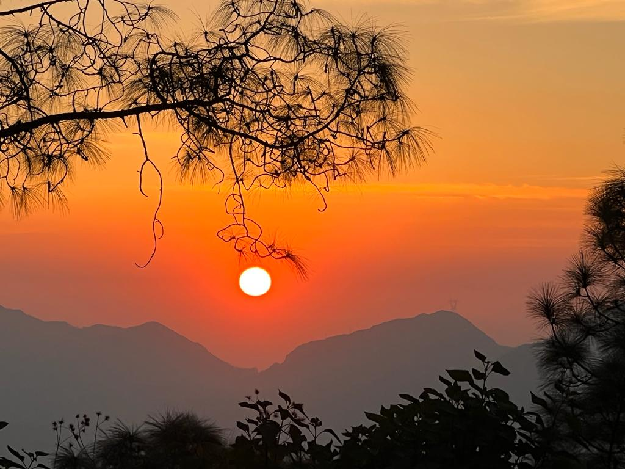
Future Trails
Yamuna River Trail
North East Trail
Indian West Coast Trail
Indian East Coast Trail

Slide 22
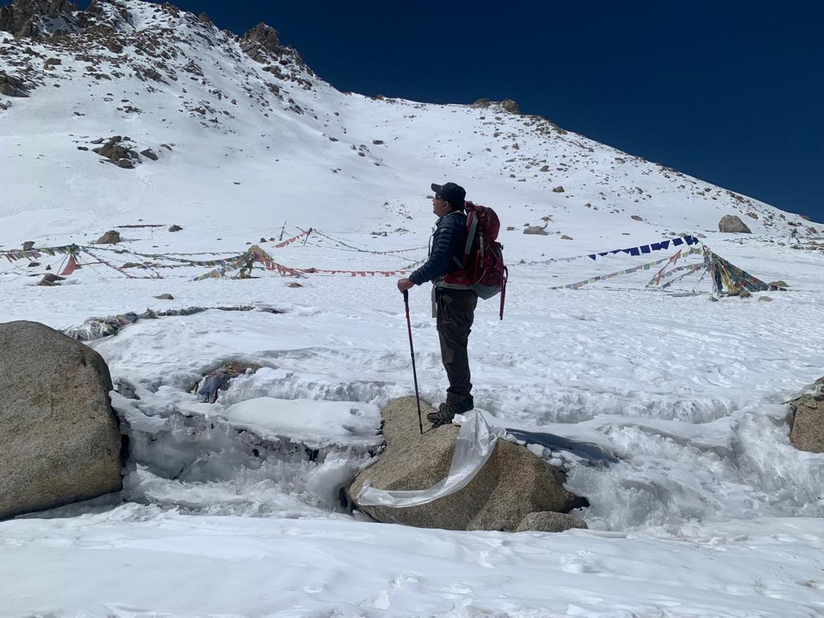
Moving Forward
Onboarding MoEFCC, MEA, MHA
State governments : Ecotourism boards/ Tourism & Forest Departments
Route
Trail Governance
Detailed planning
Access & infrastructure
Training modules by IITTM
Rescue management system
Sustainable design of homestays/ campsites
Carrying Capacity for sections and trail
Project funding
Mapping the trails/ Apps
Waste management
Rescue posts and evacuation system
Ancillary trails
Insurance

Slide 23
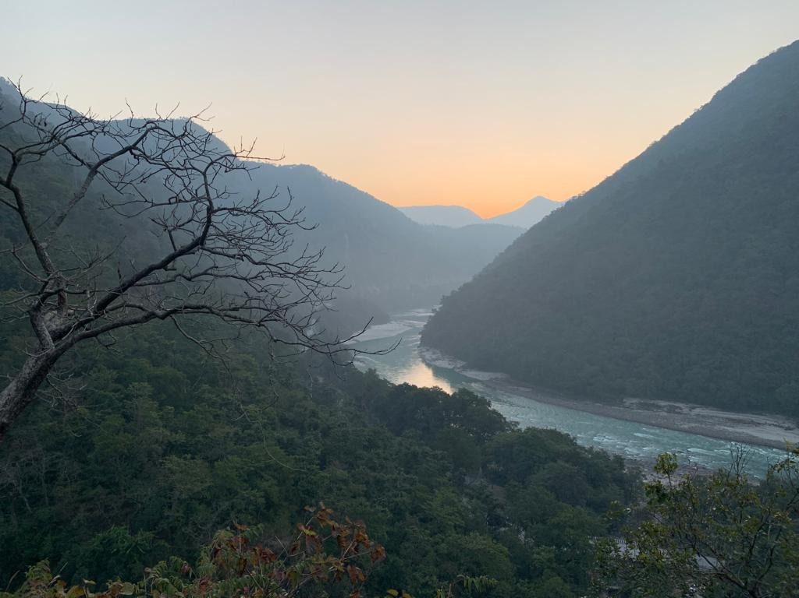
Take only photographs…….
Leave only footprints………

